Slide 1
Demystifying AngularJS
应用部 周连毅

Slide 2
What is AngularJS
A client side JS Framework
Developed and being matained by Google
Goals
Separate DOM manipulation from application logic
Seperation of concerns(Using MVC Patterns)
Make SPA development easy
Provide solid foundation for enterprise-scale JS client-side applications
Extensibility & Customization

Slide 3
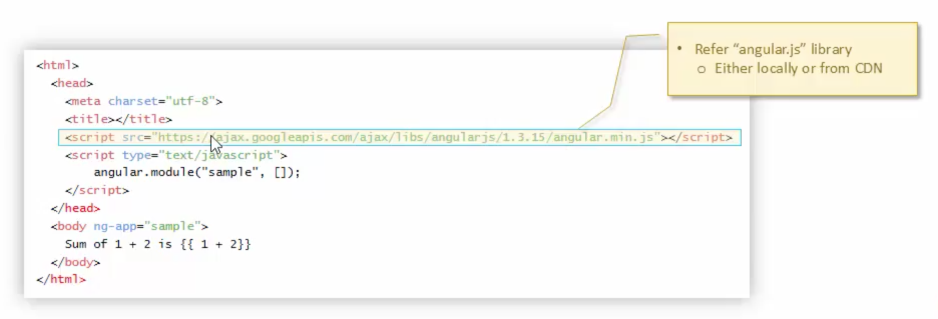
Make AngularJS availabel to Web Page
Download/refer angular-version-x.js on your page

Slide 4
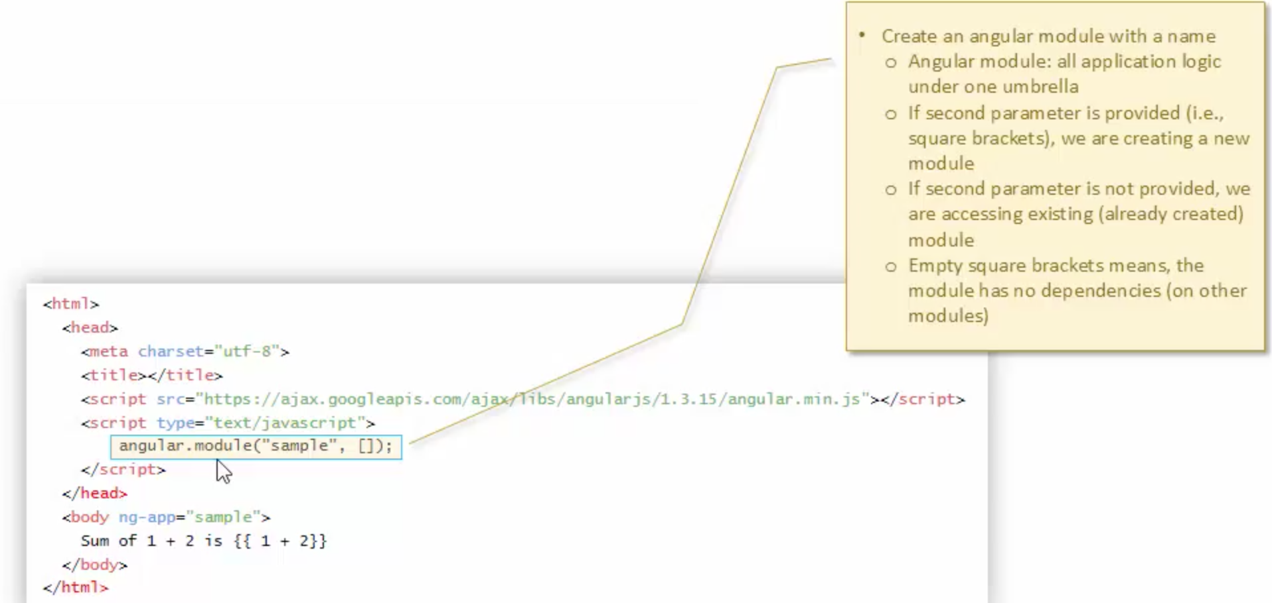
Make AngularJS availabel to Web Page
Define an angular module using “angular.module”

Slide 5
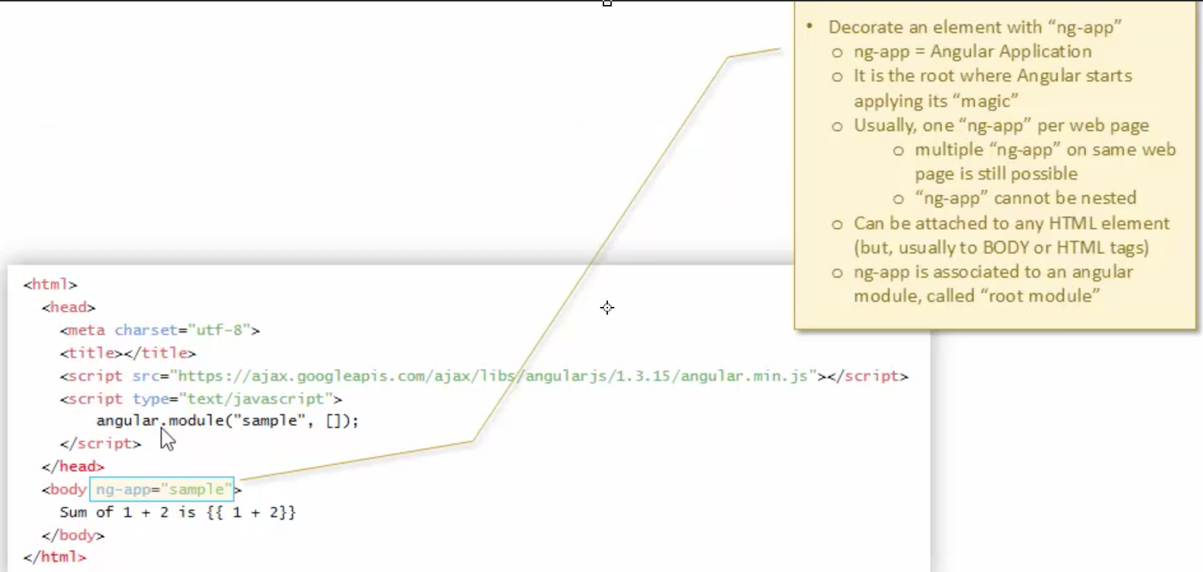
Make AngularJS availabel to Web Page
Decorate an element using “ng-app” and attach to the module

Slide 6
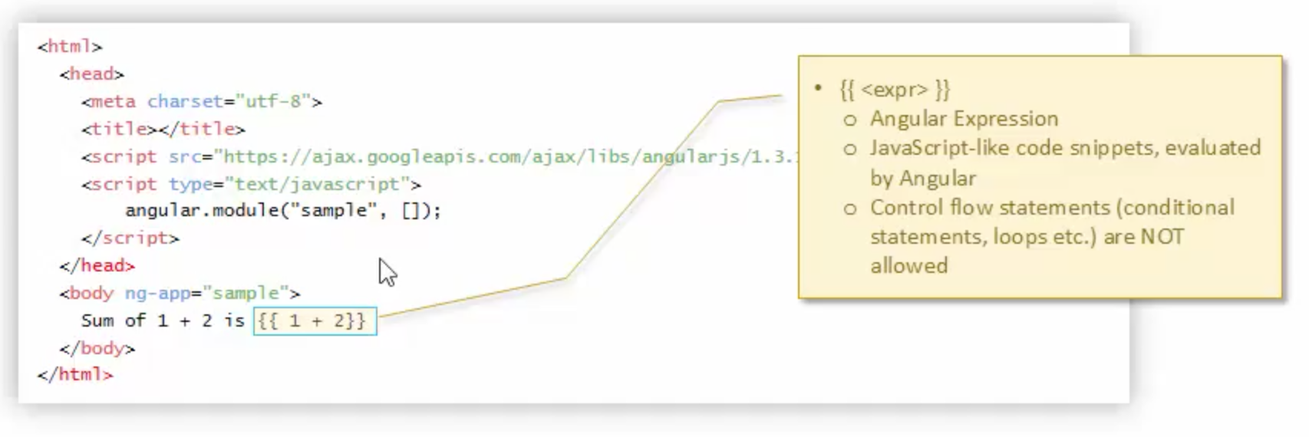
Make AngularJS availabel to Web Page
Use an angular expression to test angular js

Slide 7
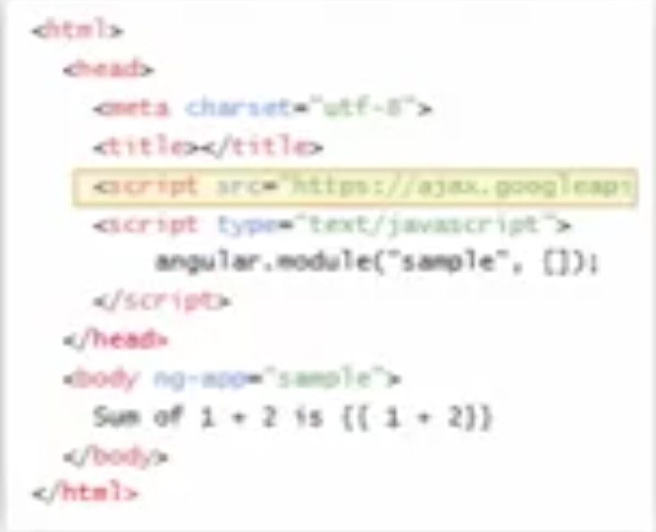
Angular Process Overview
Angular.js is included and executed

Slide 8
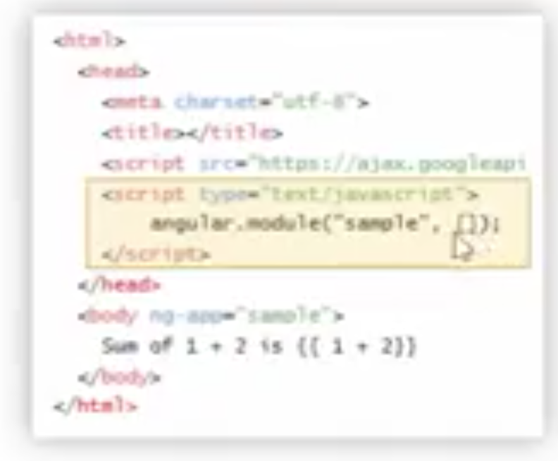
Angular Process Overview
Angular Module gets created

Slide 9
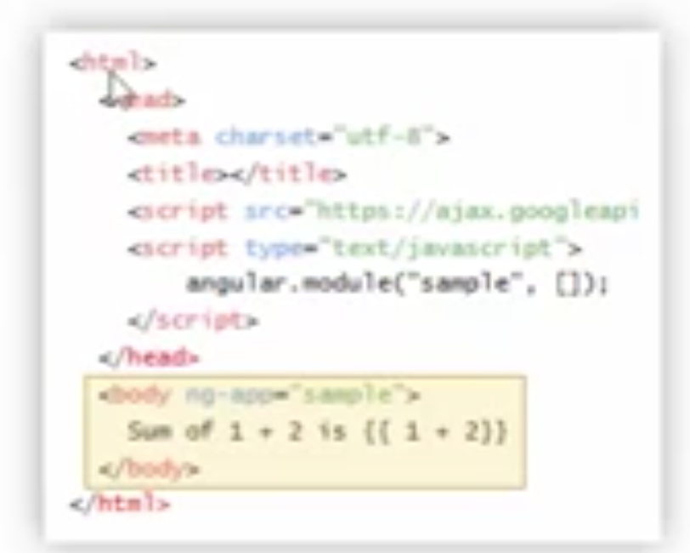
Angular Process Overview
Finds ‘templates’:
‘ng-*’ attributes (directives)
Evaluating expressions
data-binding markup etc.

Slide 10
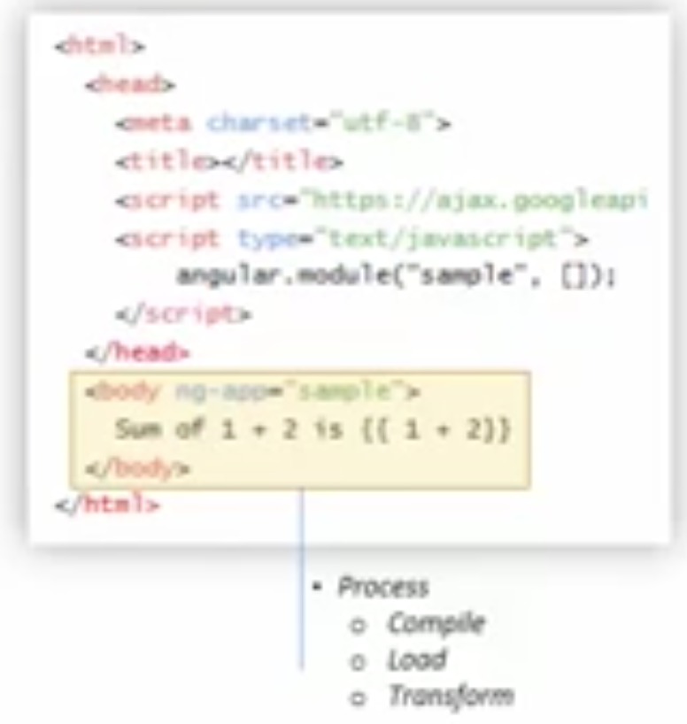
Angular Process Overview
Processes ‘templates’:
Compiles template
Loads template
(instance) in memory
Transforms template
with data
data binding
Evaluation of
expressions

Slide 11
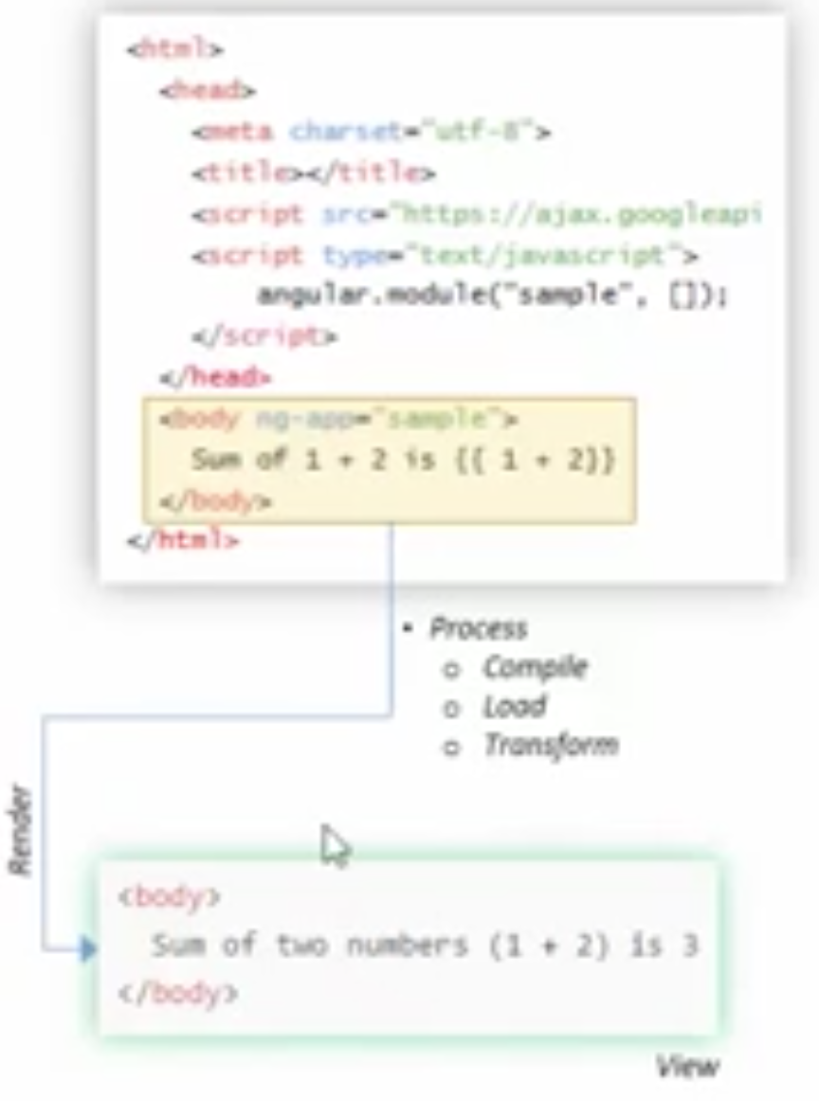
Angular Process Overview
Renders to DOM tree
(View)

Slide 12
AngularJS - Controllers
Controllers are JavaScript objects which contains application logic
usually defined as part of angular module
Allows us to send/receive data between DOM(views) and application logic
Usually attached to a DOM element using ‘ng-controller’ attribute(directive)
Gets Instatiated
In other words , exposes data(Model) to be consumed by Views (one-way data binding)
Also sends takes data from Views (two-way data binding)

Slide 13
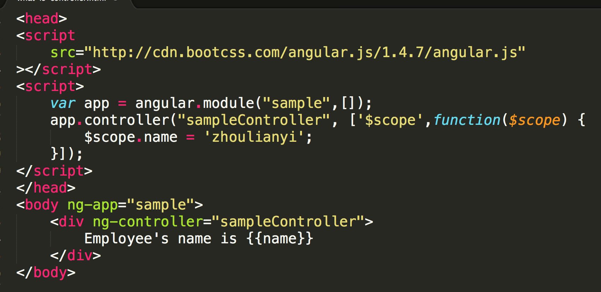
AngularJS - Controllers

Slide 14
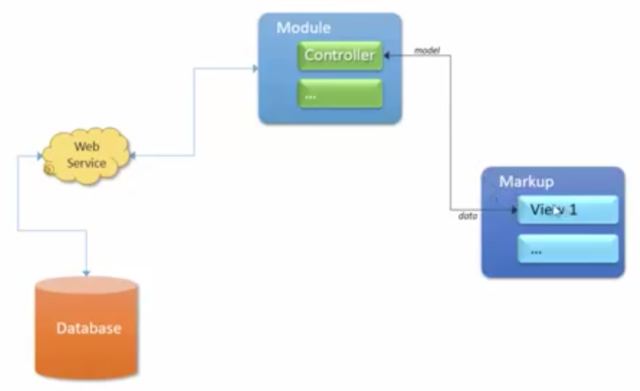
AngularJS - Controllers

Slide 15
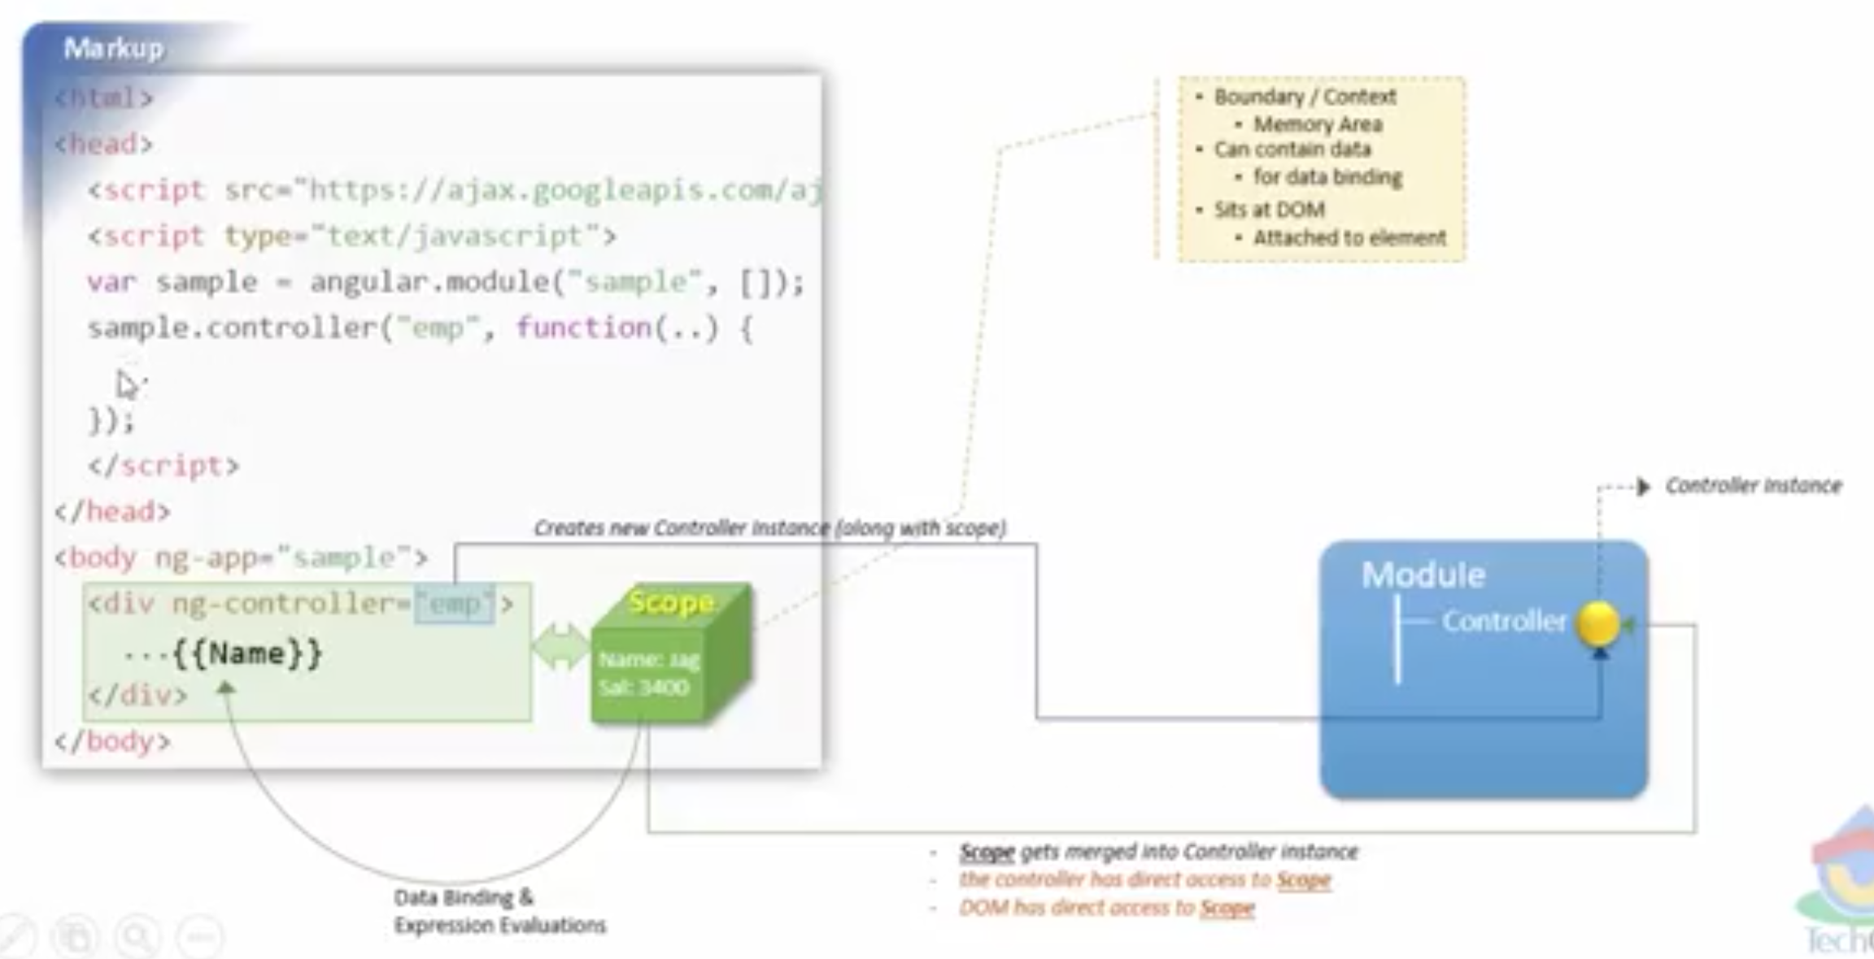
What is Scope in Controller

Slide 16
Scope Inheritance
Inner Scope gets members from Outer Scope
Multi-level Scope Inheritance
How does it works
Binding members to Outer Scope from Inner Scope(in View --- using ‘as’)
Using Outer Scope members in Inner Scope(Using Controllers --- using ‘$parent’)

Slide 17
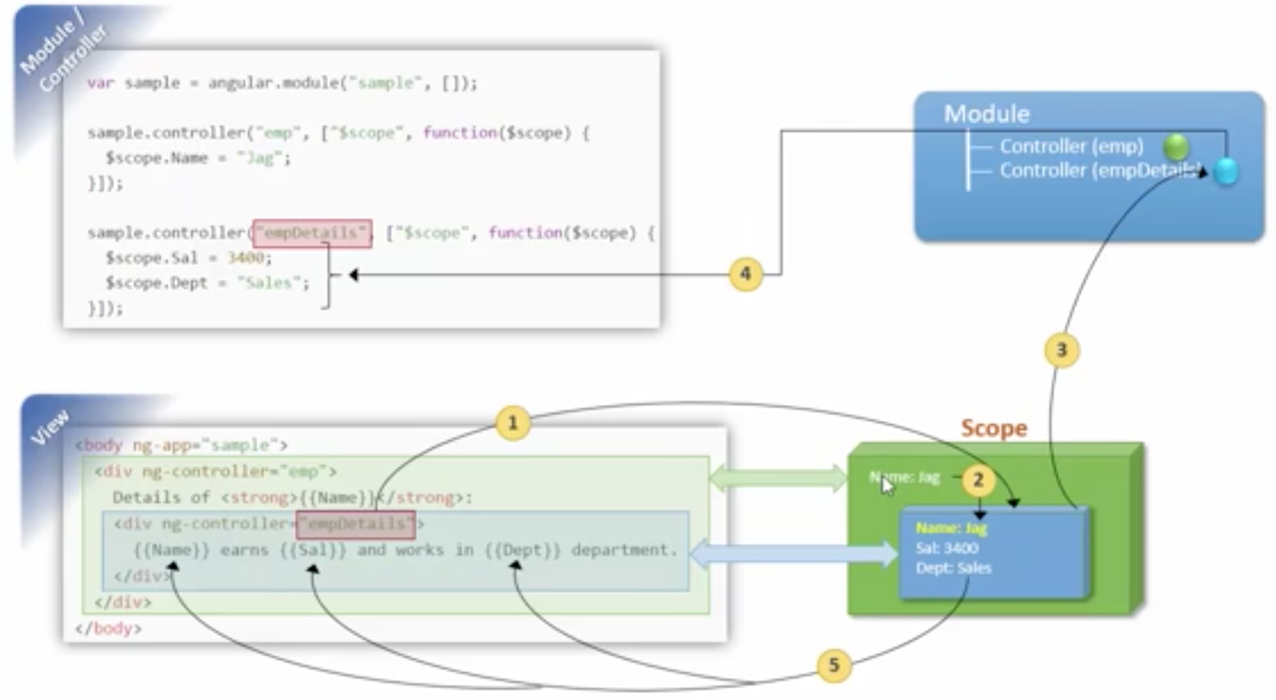
Scope Inheritance

Slide 18
Scope debug technique
angular.element($0).scope()
angular.element($0).scope().$parent()

